Slide 1
Predicting Housing Price using Regression methods
On Ames Iowa Housing Data

Slide 2
Problem Statement
To create a model to predict the housing price for a house seller based on Ames Housing Dataset.

Slide 3
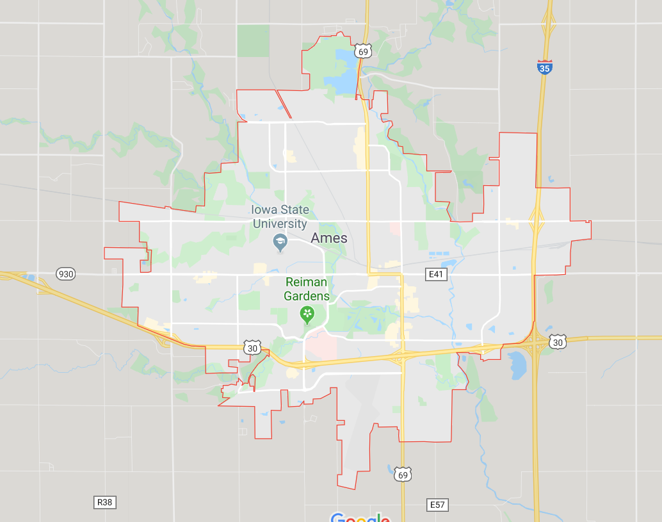
Ames IOWA
Ames is a city in Iowa United States, approximately 30 miles (48 km) north of Des Moines in central Iowa.
Home of Iowa State University (ISU), with leading Agriculture, Design, Engineering, and Veterinary Medicine colleges.
hosts United States Department of Agriculture (USDA) sites: the largest federal animal disease center in the United States
USDA's Agricultural Research Service's National Animal Disease Center (NADC)
one of two national USDA sites for the Animal and Plant Health Inspection Service (APHIS),
Ames is the headquarters for the Iowa Department of Transportation.
In 2017, Ames had a population of 66,498.Iowa State University is home to 36,321 students (Fall 2017),which make up approximately one half of the city's population.
In 2010, Ames was ranked ninth on CNNMoney's "Best Places to Live" list.
Source: Wikipedia

Slide 4

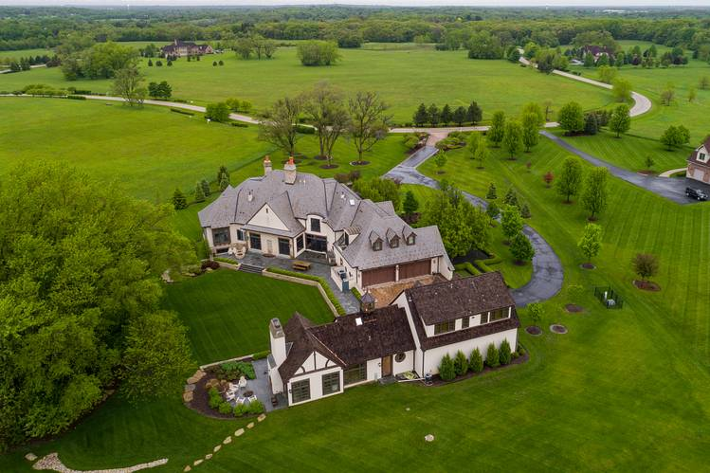

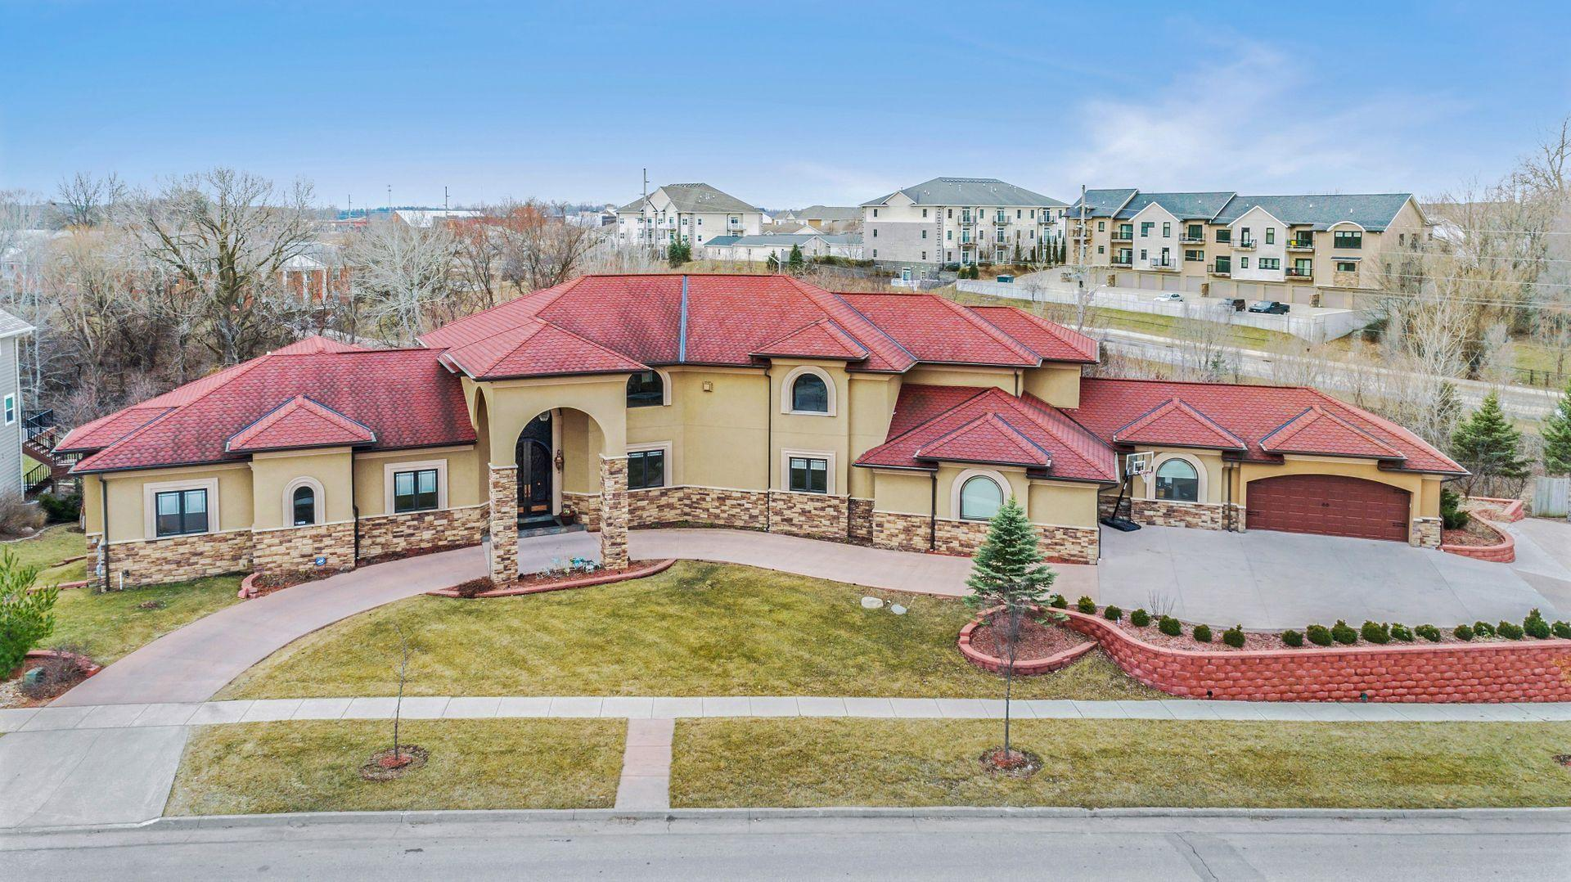
Dream home

Slide 5
What do Home Buyers look for?
How big is the house?
How old is it?
What's the house condition?
How many bedrooms?
How many bathrooms?
How is the Kitchen> -> dummy from 'Kitchen Qual'
Is the basement finished?
How big is the garage?
Does it near amenities/park/busy roads?
Is the neighbourhood safe?

Slide 6
Possible Variables for consideration
About the Unit
About the Surrounding
(outside the unit)
Lot Size
Total Living Space (above ground + base total/finished?)
Condition of the house (Rating?)
No of bedrooms
No of bathrooms
Kitchen condition/quality
Garage size (how many cars)
Basement: finished?
Age of the house
Condition of the house (structural materials, remodelling,)
Location
Easy access to amenities
Easy access to main road
Access to transportation
Traffic flow
Which neighbourhood
Location within the neighbourhood

Slide 7
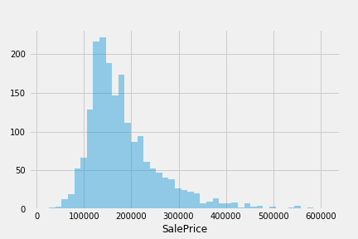
Ames Iowa Housing Data
Totally 2930 sales transactions of individual residential property in Ames, Iowa from 2006 to 2010
Each transaction contains 81 variables describing the quality and quantity of many physical attributes of the property
The sales records came in two files
train.csv -- contains 2051 rows and 81 columns for training purpose
test.csv -- contains 879 rows and 80 columns for testing.
Ames Housing Price
Min: $ 12789.0
Mean: $183847.0
Median: $164900.0
Max: $611657.0

Slide 8
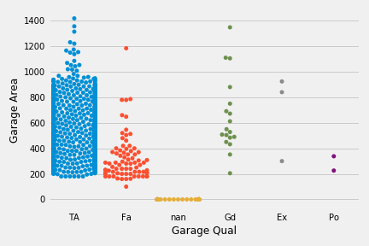
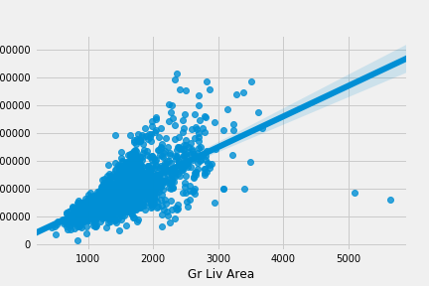
Data Cleaning and Exploratory Analysis
Missing data was treated – there are 2 types of missing data
Missing due to feature not available on the property, these entries were given a lowest numeric value when the feature is rating encoded. For example:
Garage Quality
Fireplace Quality
Missing due to other reasons
Columns with >80% missing data were removed
Columns with < 3% missing: entries were removed
Others: mean or mode value was imputated
Abnormal observations were also addressed,
for example: very large house sold for very low price were removed, as transaction like this doesn’t represent a normal transaction, but their presence would skew the model.
Missing Garage Quality, but area value is 0, indicating the property doesn’t have a garage
Outliers

Slide 9
Procedure
Feature selection
Common Sense:
16 features were selected, and used as baseline
Correction and heatmap results
30 features were finalized
Standard Scaling
Modelling
Linear Regression
Lasso Regression
Ridge Regression
ElasticNet Regression
Results Evaluation
R2 score
Residual plot

Slide 10
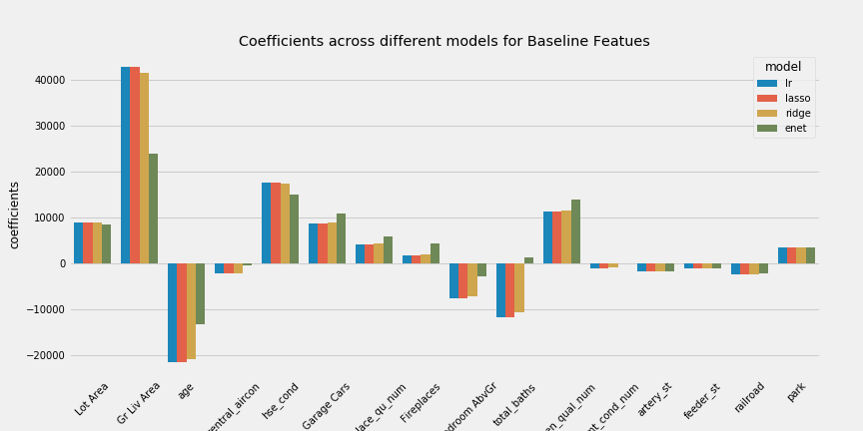
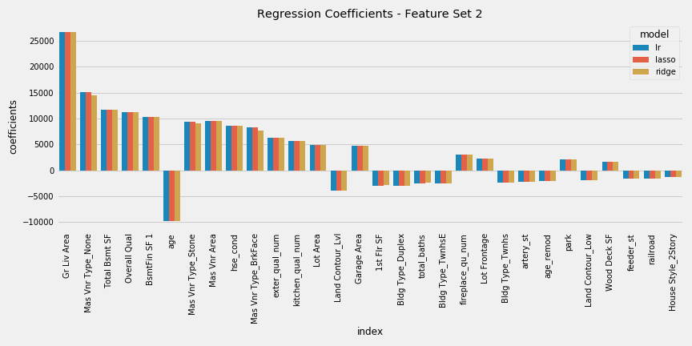
Results
Baseline Feature (16 variables)
The second feature set (30 variables)
Although the results of the second set (30 features) is higher, but that's likely due to the increase of variables, as we don't observe obvious improvement with the residual plots (next slide)
Linear Regression CV R2 scores: 0.8230414849935975
Lasso Regression CV R2 scores: 0.8230426757736862
Ridge Regression CV R2 scores: 0.8232060665455576
ElasticNet Regression CV R2 scores: 0.8066884287071131
Linear Regression CV R2 scores: 0.8798620755441716
Lasso Regression CV R2 scores: 0.8798620466267956
Ridge Regression CV R2 scores: 0.8797813251704966

Slide 11
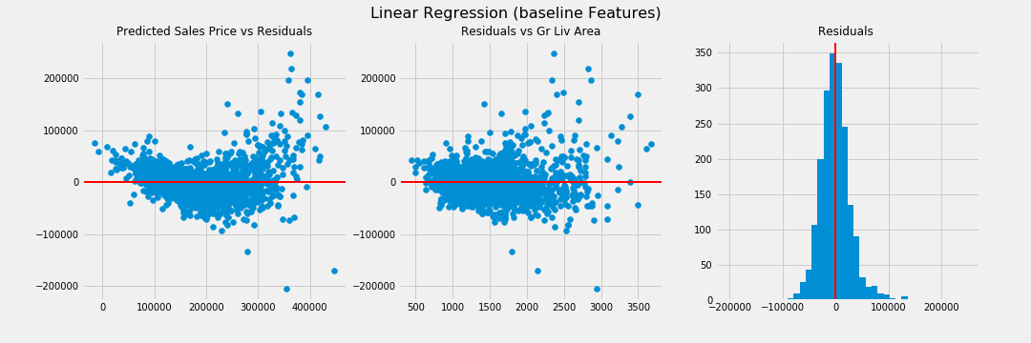
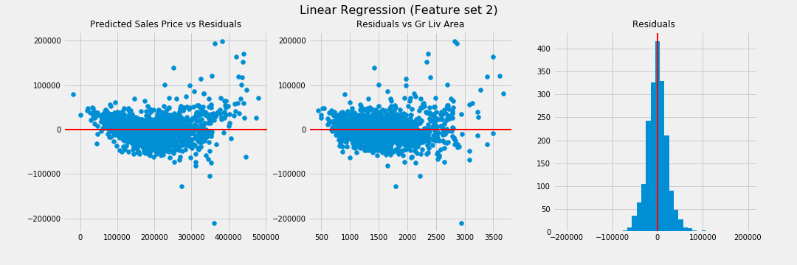
The None-linearity and homoscedasticity in the residual plot suggests that the target is not normally distributed (which is what we observed).
Properties at two sides of the scale (very small or very big properties) will be underestimated by the regression model.

Slide 12
Recommendation
The model revealed that the key variables that contributes to higher sale price are:
Above ground living space
House condition
Kitchen quality
Variable that would affect sale price negatively is the age of the property
Recommendation to home seller:
Upkeep your house condition and kitchen quality!

